Slide 1

Data Science Training
Week 1

Slide 2
Approach
Topics include data preparation, talent insights and machine learning.
Assume some statistics knowledge.
May split to two groups based on time zone for training.
Focus on open source tools for data prep and machine learning tools. Specifically R.
Guided self learning approach will be taken. Lots of practical work. Commitment of a significant amount of offline hours will be required.

Slide 3
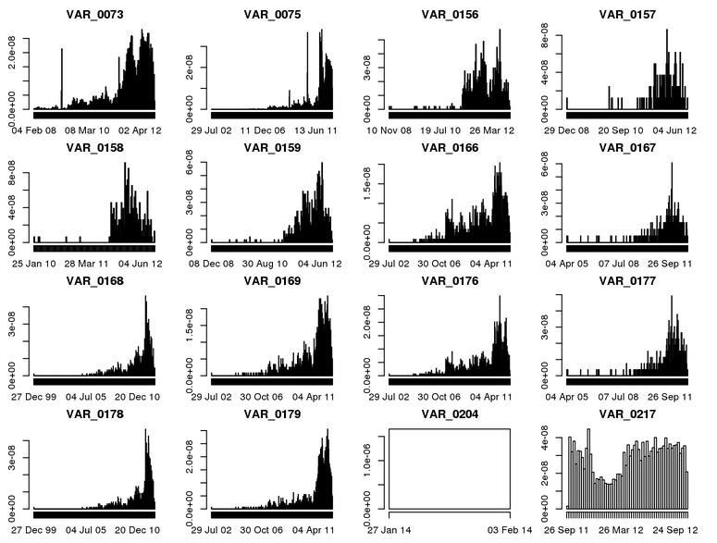
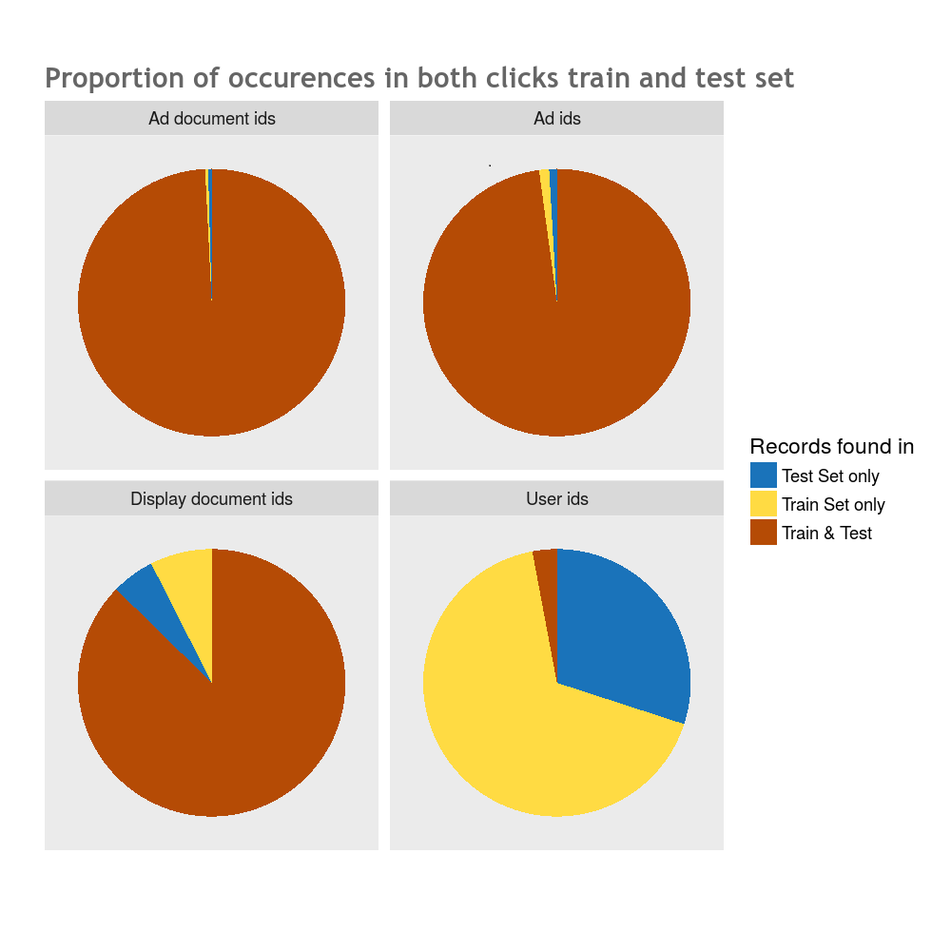
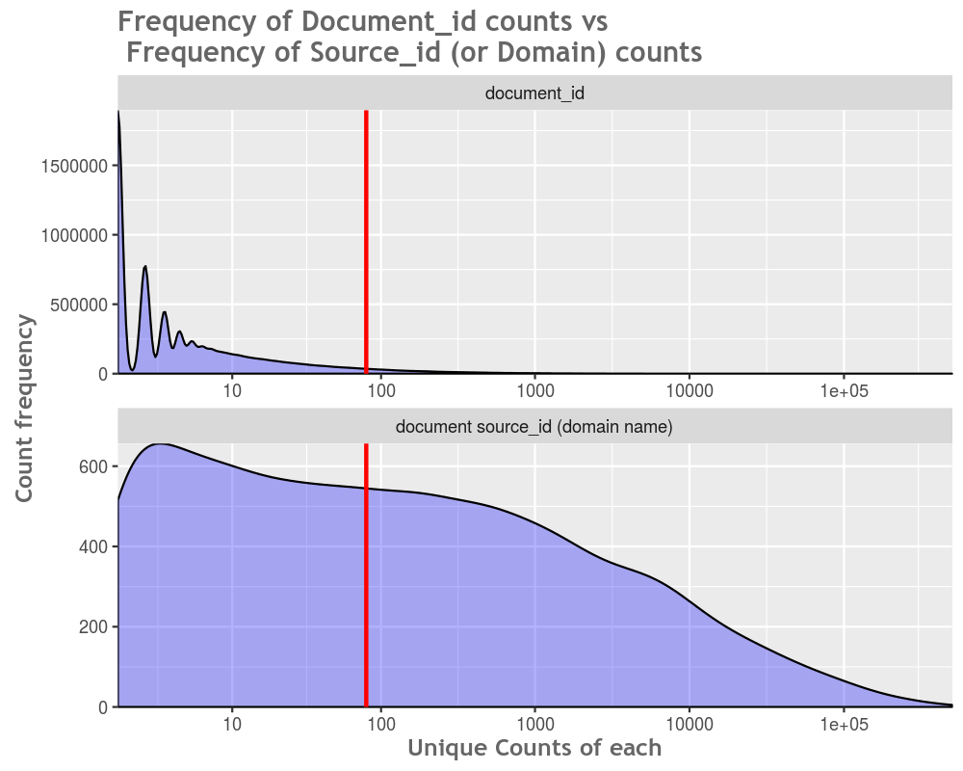
Hi Level sequence
Download and first steps in R and high level on ML
Data manipulation – rows, columns, filtering etc.
Data reshaping
String manipulation
Linear regression
Logistic regression
Regularization (for linear models)
Trees intro
Random Forest/ Bagging
Gradient boosting

Slide 4
ML Knowledge Curve
R, Python
Benefit
SPSS
Excel
Knowledge

Slide 5
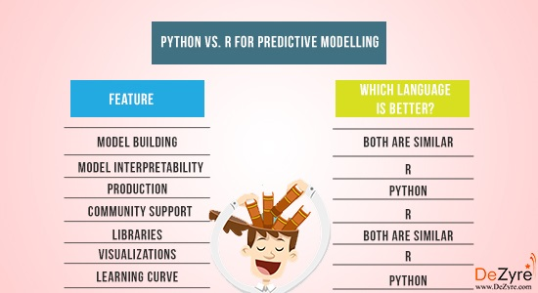
Python vs R
Both are pretty good for most of the below tasks….
Personal Thoughts
Python
Python
Python
Both are Similar
Both are Similar
R
R ? Not sure…
Data Munging
R
R

Slide 6
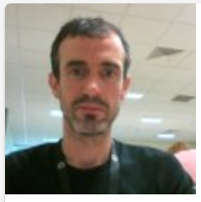
Darragh
Educational background in maths, stats and engineering. Taking ML Masters currently @ Georgia Tech. I try to keep up to speed on ML developments by participating on Kaggle – a predictive analytics competition platform.
Professional background in forecasting, BI and planning. Mainly in the hi-tech space. Started on ML about four years ago. Learnt most of what I use from ML competitions or colleagues.
Favourite tools : R (… recently I started using data.table which supercharges R runtime performance !)
Something about myself : Currently training for a marathon on 30th October, and unfortunately have an ambitious coach in my club.

Slide 7
Thank you!

Slide 8
Backup
Warwick Uni - Iris Data Set
http://www2.warwick.ac.uk/fac/sci/moac/people/students/peter_cock/r/iris_plots/

